Slide 1
MIS775 – Decision Modelling for Business Analytics – Trimester 1 2024 Assessment Task 1 – Investment Portfolio Optimization – Individual
Anagha prashanth raje urs
S223709844
s223709844@deakin.edu.au

Slide 2
SECTION 1. PRELIMINARY WORK
Introduction
we focus on developing decision models using sophisticated quantitative methods to optimize investment portfolios with live market data. specifically, we'll use stocks from the Australian stock exchange, including bhp group and Orica limited for basic materials, Lendlease group and goodman group for real estate, car limited and technology one limited for technology, and Telstra corporation and APA group for telecom. these selections are intended to create a diverse and balanced portfolio aligned with industry and risk categories, applying linear programming (LP), integer linear programming (ILP), and non-linear programming (NLP) optimization techniques to meet the learning objectives of conceptualizing and formulating business problems as decision models.
Stock (asset) selection.
selecting stocks for the assignment involves analysing volatility through covariance and mean returns. lower covariance stocks, like TLS and ORI, are less volatile and hence lower risk. stocks like bhp and car, with moderate covariance, represent medium risk. high covariance stocks, such as GMG and LLC, imply higher volatility and risk.
Risk group classifications.
risk groups classified between r1, r2 and r3 are made with the following categoric differences:
less than 6 standard deviations in r1, 6 to 8 under r2 and more than 8 r3. telecom comes under r1. Orica from basic materials and car and TNE from technology constitute r2 and r3 includes bhp from basic materials and real estate stocks i.e. GMG and LLC.

Slide 3
LP MODEL

Slide 4
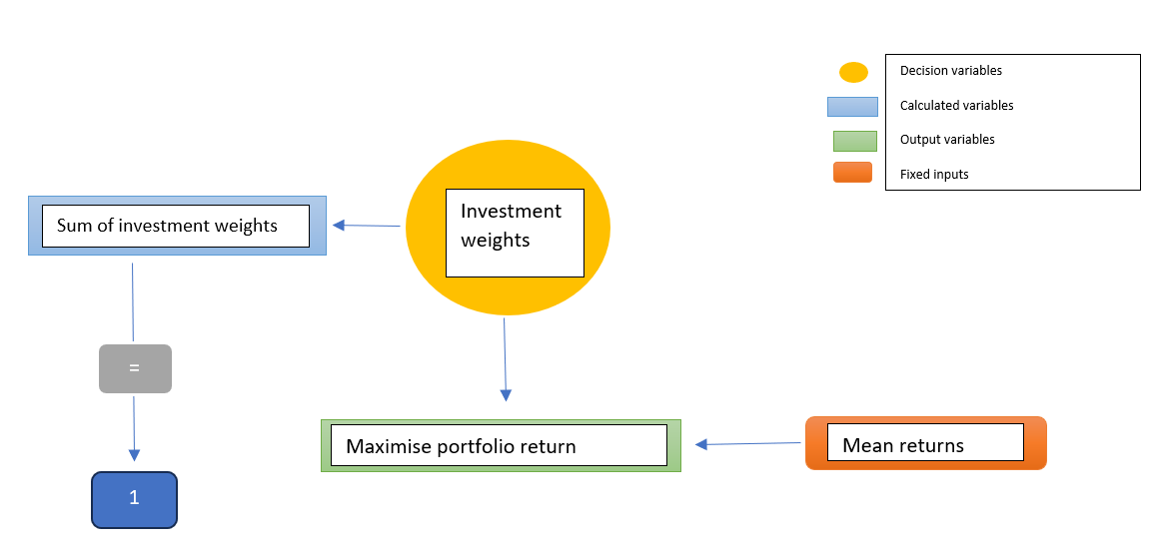
SECTION 2. OPTIMISATION MODELS
LP model
Conceptual diagram

Slide 5
Optimal solution
objective achieved: average return maximized to 1.15%.
strategic investments: significant weights in ORI (20%), TNE (30%), and TLS (30%).
constraints met: 30% minimum in r1, 20% max in r3, over 25% in basic materials, at least 15% in real estate, and 30% in technology sector.
total investment: 100% capital allocated across selective stocks

Slide 6
Algebraic formulation
let the decision variables be a1, a2, a3, a4, a5, a6, a7, a8 for stocks bhp, ori, gmg, llc, car, tne, tls, apa respectively.
objective function will be to get maximum returns
maximum overall returns = (a1*0.0089) +(a2*0.0040) +(a3*0.0136) +(a4*-0.0095) +(a5*0.0184) +(a6*0.0198) +(a7*0.0075) +(a8*-0.0021)
subject to following constraints:
(a7*0.0075) +(a8*-0.0021) =r1 to be at least 30%
(a1*0.0089) +(a3*0.0136) +(a4*-0.0095) ≤ 20% in r3
(a1*0.0089) +(a2*0.0040) ≥25% in basic materials
(a3*0.0136) +(a4*-0.0095) ≥15% in real estate
(a5*0.0184) +(a6*0.0198) ≥ 30% in technology
(a1*0.0089) +(a2*0.0040) +(a3*0.0136) +(a4*-0.0095) +(a5*0.0184)+(a6*0.0198)+(a7*0.0075)+(a8*-0.0021) = 100% of the total portfolio investment

Slide 7
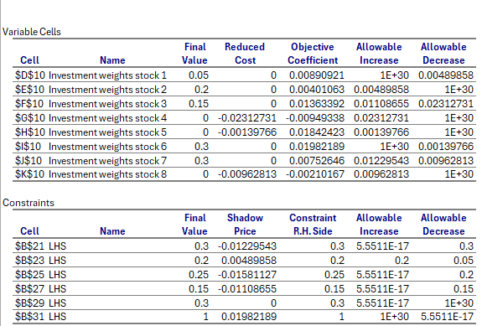
Image of sensitivity report

Slide 8
ILP MODEL

Slide 9
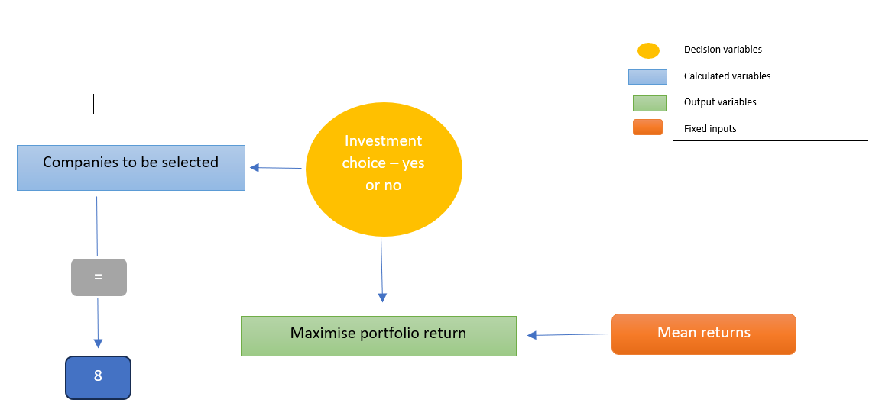
ILP model
Conceptual diagram

Slide 10
Algebraic formulation
let a1, a2, a3, a4, a5, a6, a7, a8 be decision variables
the objective function is to attain maximum returns
(a1*0.0089) +(a2*0.0040) +(a3*0.0136) +(a4*-0.0095) + (a5*0.0184)+(a6*0.0198)+
(a7*0.0075)+(a8*-0.0021) = 6
subject to:
(a1*0.0089) + (a2*0.0040) ≥ (c1 greater than 1)
(a5*0.0184) + (a6*0.0198) ≥ (c2 greater than 1)
(a7*0.0075) + (a8*-0.0021) ≥ (c3 greater than 1)
(a3*0.0136) + (a4*-0.0095) ≥ (c4 greater than 1)
(a1*0.0089) + (a3*0.0136) + (a4*-0.0095) ≤ (investing not more than one‐third in r3)
(a7*0.0075) + (a8*-0.0021) ≤ (maximum of 2 investments only in r1)
(a2*0.0040) + (a5*0.0184) + (a6*0.0198) ≥ (at least 1 investment in r2)

Slide 11
Optimal solution
Achieved return: 1.21% average portfolio return.
Allocation: equal weights to BHP, ORI, GMG, CAR, TNE, AND TLS; LLC AND APA excluded.
Compliance: constraints for investment categories (r1, r2, r3) met, ensuring diversified risk.
Strategy insight: the model excludes negative mean stocks, balancing risk and return.

Slide 12
Interpretation
Decision variables:
using investment weights
stocks included: BHP, ORI, GMG, CAR, TNE, TLS indicated as ‘1’.
stocks excluded: LLC, APA indicated as ‘0’.
objective function
the objective is to maximize the average portfolio return, which is calculated to be 1.21%.
constraints (in relation to ILP model requirements):
total investments: there must be exactly 6 investments, as indicated by the constraint lhs = rhs = 6.
category inclusion: the constraints with lhs ≥ 1 for each category (c1 to c4) ensure at least one investment is chosen from each category.
risk group constraints:
r3 (high risk): lhs ≤ 2 ensures that no more than two investments (one-third of the portfolio) are in the riskiest group r3.
r1 (low risk): lhs ≤ 2 ensures that at most two investments are in the least risky group r1.
r2 (moderate risk): lhs ≥ 1 ensures that at least one investment is in the moderate-risk group r2.

Slide 13
NLP MODEL

Slide 14
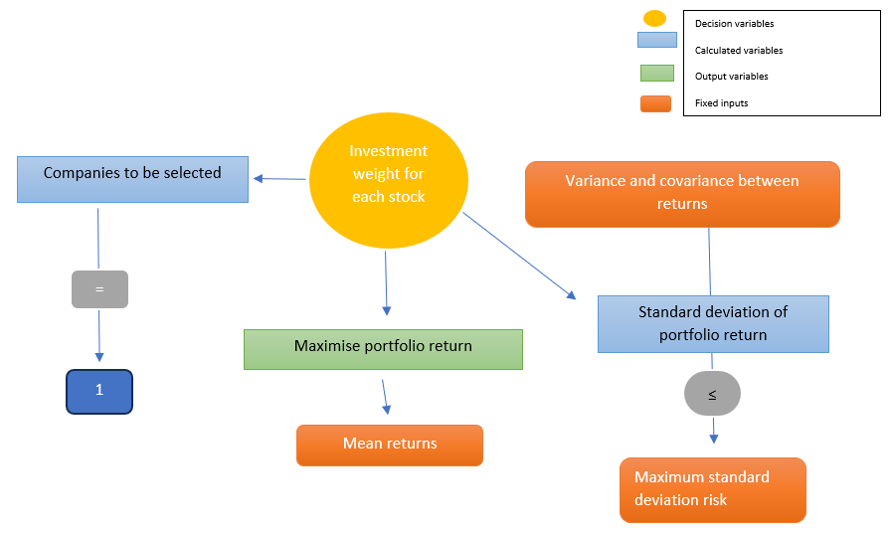
NLP models
Maximise return - Conceptual diagram

Slide 15
Algebraic formulation
let ‘a’ be the weight of the stocks.
the objective is to attain maximum overall return, subject to an upper limit on the portfolio risk.
thereby multiplying the variable ‘a’ with the mean.
maximum overall return = (a1*0.0089) +(a2*0.0040) +(a3*0.0136) +(a4*-0.0095) + (a5*0.0184)+(a6*0.0198)+(a7*0.0075)+(a8*-0.0021)
subject to :
sum product of covariance table
a1 + a2 + a3 + a4 + a5 + a6 + a7 + a8 = 1 portfolio = 100% of total investment

Slide 16
Optimal solution
Expected return: portfolio designed to yield a 1.08% average return.
Risk management: risk maintained at a 3% standard deviation, meeting the set risk level.
Concentration: predominant investment in stock 7 (59.77%), with notable allocations in stock 1 (11.33%) and stock 5 (18.93%).
Diversification: investments spread across 5 out of 8 stocks, excluding those with negative expected returns.
total allocation: investments meticulously calibrated to constitute 100% of the portfolio

Slide 17
Interpretation
Optimization of a stock portfolio using mean-variance analysis.
The model aims for the highest return at a defined risk level, with expected returns and risk (covariance) for each stock provided as inputs.
The decision variables show the optimal investment allocation, with a heavy preference for stock 7.
Constraints ensure risk does not surpass 3% and total investment equals 100%. the calculated average portfolio return is 1.08%, reflecting the balance between risk and reward.
This model exemplifies a strategic approach to asset allocation, aligning with specified risk tolerances and maximizing expected returns.

Slide 18
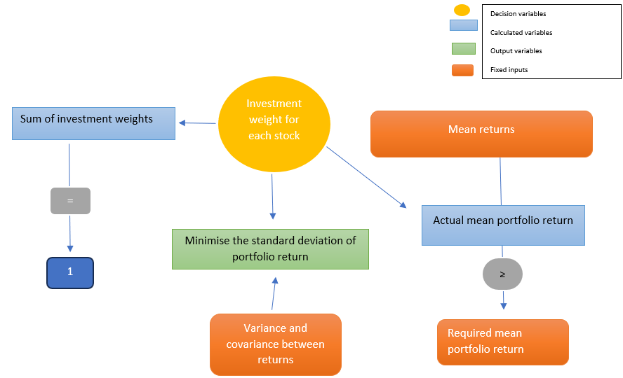
B) Minimise portfolio risk
Conceptual diagram

Slide 19
Algebraic formulation
Minimise portfolio investment = sum product of covariance table
subject to:
(a1*0.0089) +(a2*0.0040) +(a3*0.0136) +(a4*-0.0095) + (a5*0.0184)+(a6*0.0198)+(a7*0.0075)+(a8*-0.0021) ≥ (minimum expected return of 1%)
a1 + a2 + a3 + a4 + a5 + a6 + a7 + a8 = 1 portfolio = 100% of total investment

Slide 20
Optimal solution
Objective Attained: 1.00% average portfolio return.
Risk Managed: Portfolio risk at a 4.28% standard deviation.
Investment Distribution: Allocations range from 6.34% to 16.18%, with the highest in stock 6.
Diversity Achieved: All stocks except for those with negative means are included in the portfolio.
Constraints Met: The expected return meets the minimum threshold of 1%; total investment weights equal 100%.

Slide 21
Interpretation
The portfolio optimization model uses mean returns and a covariance matrix to determine the systematic risk between stocks.
Investment weights dictate capital allocation per stock, directly affecting portfolio variance and risk. the goal is to minimize risk with a standard deviation of 4.28%, while ensuring an average return of at least 1.00%.
Constraints mandate a minimum 1% return, reinforcing the target yield, and require total investment weights to sum to 100%, assuring full capital deployment.
The model strategically seeks the lowest risk while satisfying the return criterion and fully utilizing investment capital.

Slide 22
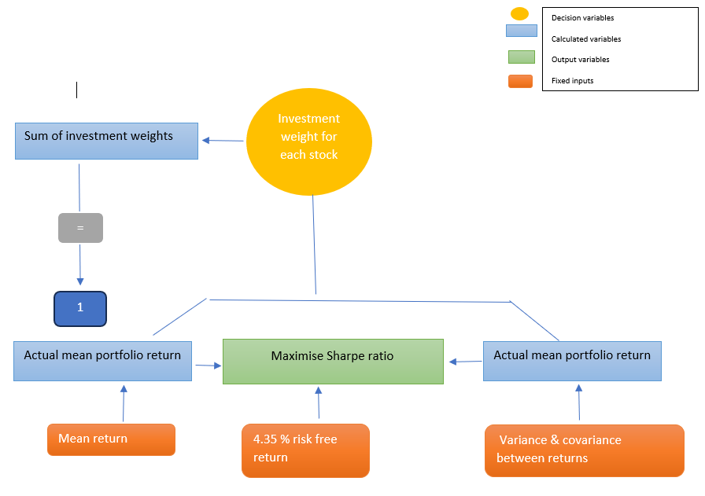
C) Maximise the Sharpe ratio.
Conceptual diagram

Slide 23
Algebraic formulation
since risk free return is considered to be 4.35% (4.35/12 = 0.3625%)
the main objective here is to achieve maximum risk adjusted return which is the sharpe ratio.
Maximise sharpe ratio formula: expected return – risk free rate/standard deviation of portfolio
(a1*0.0089) +(a2*0.0040) +(a3*0.0136) +(a4*-0.0095) + (a5*0.0184)+(a6*0.0198)+(a7*0.0075)+(a8*-0.0021) – (0.3625)/ sum product of covariance table
Subject to:
a1 + a2 + a3 + a4 + a5 + a6 + a7 + a8 = (Portfolio = 100% of total investment)

Slide 24
Optimal solution
The portfolio optimizes for the sharpe ratio, with an allocation focused on stocks 1, 5, 6, and 7, yielding a 1.37% average return at a 3.93% risk level.
stocks 2, 3, 4, and 8 are excluded, likely due to negative impacts on the risk-adjusted return.
The resulting sharpe ratio of 0.26 demonstrates the efficiency of the portfolio relative to its risk, adhering to the constraint that the total investment weights equal 100%

Slide 25
Interpretation
The optimization model for the portfolio focuses on optimizing returns when adjusted for risk, using the sharpe ratio as the performance metric, considering a risk-free rate of 4.35% yearly.
Input data includes average stock returns and their covariances. the decision variables determine the proportion of the portfolio's capital invested in each stock.
The model evaluates risk using portfolio variance and a standard deviation of 3.93%, alongside an average return of 1.37%.
The resulting sharpe ratio is 0.26, reflecting the additional return achieved per unit of risk over the risk-free benchmark.
A sole constraint guarantees complete investment of the available capital, ensuring investment weights total to 100%.

Slide 26
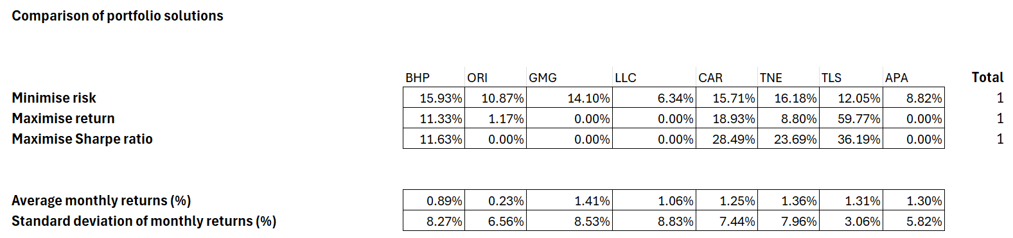
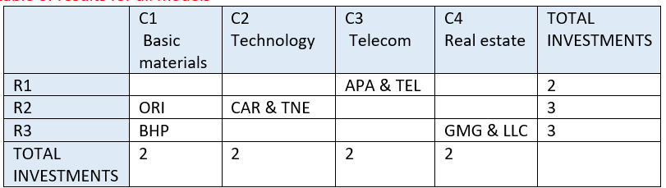
Summary table of results for all models
Summary table used to determine the parameters of risk and classifying them under R1, R2 and R3.

Slide 27
Preferred strategy
our portfolio strategy prioritizes maximizing risk-adjusted returns, focusing on diversification and excluding negative-return stocks. the allocation balances risk across select assets, utilizing full investment capital and maintaining a controlled risk level, as indicated by the targeted standard deviation, to achieve a well-optimized and efficient investment portfolio.
based on this, for a diverse portfolio, Sharpe can be chosen to Maximise returns whilst having low risk.
Maximise is for investors looking for a higher profile. as it has high risk with high returns.

